Slide 1
Tourism for everybody
Prof.ssa Roberta F.I. Visone
Notes from my job experiences with Costa Cruises S.p.A. and Cima s.r.l.

Slide 2
WHY DO PEOPLE TRAVEL?
Business travel
Leisure travel
Visiting friends or relatives travel (VFR)

Slide 3
Defining tourism
Movement from a place to another
Visiting monuments and other places of interest
Satisfaction of needs
The world's largest and fastest growing industry

Slide 4
TYPES OF TOURISM
INCOMING/INBOUND
OUTBOUND
DOMESTIC
STAYCATION
DAY TRIPPERS/EXCURSIONISTS

Slide 5
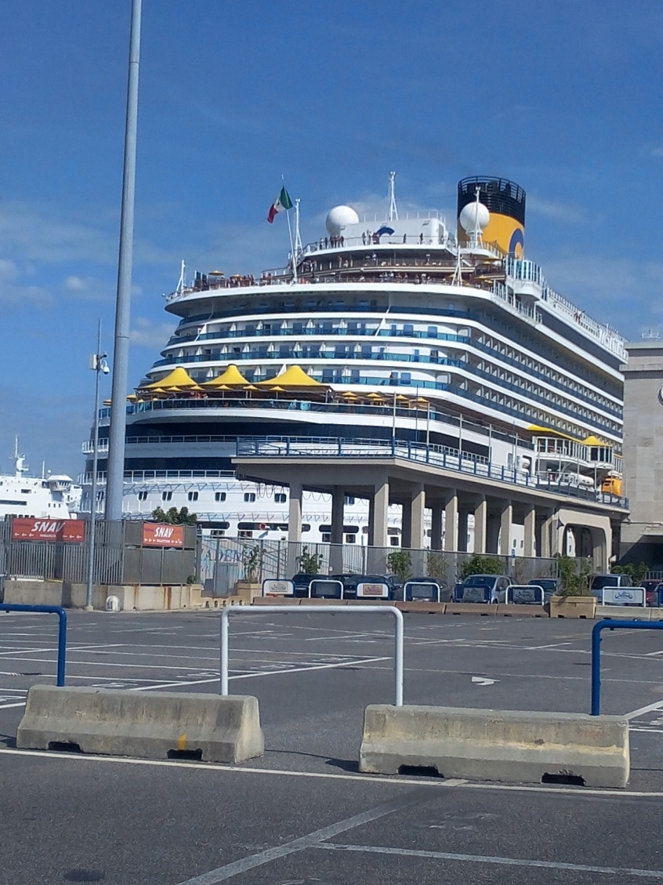
Cruise industry

Slide 6
Office members (ground staff)
Accounting and administration
Travel agents
Customer support staff
Office members (crew/board staff)
Tour Escort (TE: tour office staff)
Tour Manager (TM: leader of Tour Escorts)
Hotel Director (liable for the hotel branch, TE e TM belong to)

Slide 7
Tour office: main duties
Pre-selling
Book-keeping/Accounting
Use of SA&PI (Ship Administration and Passenger Information)
Sales of tickets for shore excursion (abbr. excu)
Folding onboard journals with the description of excu
Preparation of stickers, lollipops and of other things useful for excu
Complaint management

Slide 8
Outside the tour office…
“Stickeraggio” at meeting points inside the ship
Public Relation (PR)
Control
Escort
Jumping
Supervision (tour guides, means of transport, bus entrance and exit, restaurants, buses return, etc.)

Slide 9
Carnival group
Costa NeoRiviera (Ex Ibero Cruceros)
AIDA
Costa Cruises S.p.A.
Seabourn
Princess Cruises
Holland America Cruises (also Windster Cruise)
Regent
P&O Cruises

Slide 10
Ship opening process
(Costa and MSC - excu)
Preparation of voucher and folder with the description of the excu;
Mail correspondence for continuous updates of the dispatch and for stopover permissions (plus possible private services and/or something else);
Bus and tour guide organization: contact with suppliers to indicate and arrange the quantity and the typology of bus/guide per excu;
With progressive update of the dispatch → combo (pink and white) vouchers + other items (notepad for lotto, white envelopes for other entrances, etc.) with the quantity of folders according to the number of buses and the typology of excu;
Once received the lists of buses and guides → start compiling the Excel and Word files (Tour guide form, passengers – pax – recap per excu, recap of pax and of paid tickets – tkts – per excu).

Slide 11
Once opened the ship…
At the port for stopover (delivery of the folders with vouchers and other items – e.g. signs with bus numbers; tally of pax per excu); usually in the MORNING.
At the port for return (collection of folders with vouchers and other items – e.g. signs with bus numbers); usually at noon-in the afternoon.
Compiling of the file (Excel and Word) to close the ship;
Delivery of the copy of the excu recap file to the book-keeping staff.
ATTENTION!!!
Costa = 3 files (Tour guide form, pax recap per excu, recap of pax and of paid tkts per excu);
MSC = 2 files (Tour guide form, recap of pax and of paid tkts per excu).

Slide 12
What to deliver to the book-keeping staff
Tour guide form
Participant receipt (signed by TM and Tour Operator)
Excu recap + pink vouchers
Mail with pier permissions
Attention!
You must staple the entrance tkts in front of the vouchers, then put tkts and vouchers in front of the excu recap with the attache (graffetta). This is the order to follow:
Stapled tkts + vouchers;
Excu recap;
Blank paper for excu ooG4 and others where “Il/la sottoscritto/a _____ riceve € ___ per _____” is written

Slide 13
Necessary items for MSC and Costa
MSC | Costa
Folder with excu description
Pink vouchers
White vouchers
Notepads and envelopes (for particular excu)
2 bus numbers | 1 bus number (only Costa Diadema)
MSC sign with the name of the excu
MSC sign “Excursions”
Language(s)
Rubber band to bind the entrance tkts

Slide 14
Particular excu
MSC | Costa
“Capri & Anacapri”: neither signs nor languages or bus numbers. ONLY VOUCHERS (pink and white). | “Capri & Anacapri”, “Capri in funicolare”: no bus numbers. ONLY VOUCHERS (pink and white).
Fixed and variable prices (for quotations)
Fixed prices | Variable prices
Entrance tkt | Bus
Restaurant service | Tour guides
Tasting service
Funicular service
Earphones service
Free access - Gratuità
Shuttle bus, restaurant, funicular, private entrance tkt. On average 1 x 40 pax.

Slide 15
Combo (pink and white) vouchers + excu: Costa
Excu | White vouchers | Pink vouchers
00G4: Walking Tour | Giocate lotto (€ 50,00 per bus) + Notepad lotto game. | Pizzeria (Di Matteo) service + coffee-break service (sfogliatella + coffee in the cup) (Gambrinus) + earphones service
212: Pompei | Guide service in Pompeii | Entrance tkts Pompeii ruins + earphones service
213: Capri & Anacapri | Guide service in Capri | Tour of the island by minibus + entrance tkts Villa San Michele
219: Ercolano |  | Entrance tkts Herculaneum ruins
220: Nei meandri della Città del Sole |  | Entrance tkts Napoli Sotterranea
223: Solfatara |  | Entrance tkts Solfatara + coffee-break service
226: Vesuvio |  | Entrance tkts Vesuvio + tasting service

Slide 16
Combo envelopes and pink vouchers + excu: Costa
Excu | Envelopes | Pink vouchers
227: Capri in funicolare |  | TRSF Marina Grande/Capri/Marina Grande with roundtrip funicular service + entrance tkts Giardini di Augusto
00JE/00DY: Reggia di Caserta | Entrance tkts Reggia di Caserta (€ 12,00 per person) | Earphones service
002P: Positano & Ravello with lunch | Entrance tkts Villa Cimbrone/Rufolo | Lunch service (menù agreed)
263: Pompei | Guide service in Pompeii | Entrance tkts Pompeii ruins
265: Amalfi by boat | Entrance tkts Chiostro del Paradiso | Maritime passage Salerno/Amalfi/Salerno by boat
Amalfi by bus
266: Paestum | Entrance tkts Scavi Archeologici di Paestum
268: Napoli full day with lunch |  | Lunch service (menù agreed)

Slide 17
What to write on pink vouchers (I)
Excu |  | Rilasciato a …
00G4: Walking Tour | Pizzeria service | Spett.le Pizzeria Di Matteo
 | Coffee-break service (sfogliatella + coffee in the cup) | Spett.le Grand Caffè Gambrinus
 | Earphones service | Spett.le Audiotours
213: Capri & Anacapri | Tour of the island by minibus | Spett.le Consorzio Noleggiatori Capresi
 | Entrance tkts Villa San Michele | Spett.le Villa San Michele srl
212: Pompei | Entrance tkts Pompeii ruins | Spett.le Civita Musea srl
219: Ercolano | Entrance tkts Herculaneum ruins
RICORDA!!!
Write the same date on the letterhead and under the voice “rilasciato a”.
RIF: ship name (Costa/MSC)
REMARKS: full name of the ship (Costa Diadema/MSC Divina)
Signature and stamp +
Bus/Grp n.

Slide 18
What to write on pink vouchers (II)
Excu |  | Rilasciato a
226: Vesuvio | Entrance tkts Vesuvio | Spett.le E.N.P.V.
 | Tasting service | Spett.le Douce Atmosphère sas
227: Capri in funicolare | TRSF Marina Grande/Capri/Marina Grande with roundtrip funicular service | Spett.le Ditta Staiano Autotrasporti
 | Entrance tkts Giardini di Augusto | Spett.le Sun & Sea sas
002P: Positano & Ravello with lunch | Lunch service (menù agreed) | Spett.le Il Glicine srl
265: Amalfi by boat | Maritime passage Salerno/Amalfi/Salerno by boat | Spett.le Agenzia Viaggi De Cesare
268: Napoli full day con pranzo | Lunch service (menù agreed) | Spett.le La Notizia

Slide 19
Hotel industry
Some duties:
Booking;
Preparation of tour packages for groups (leisure, business, etc.);
Complaint management.

Slide 20
A Game of allotments
Suppliers
Write collaboration agreements with the intermediaries, giving them the allotment that will be resold to the foreign market.
Intermediaries
Travel agency and tour operator.
Clients
Foreign market.
Hotel.
Write collaboration agreements with suppliers and resell the allotment to the foreign market.
Receive collaboration agreements in foreign language and sell the allotment to foreign clients.

Slide 21
Glossary ENG-ITA-DEU
ENG | ITA | DEU
Could you sign here, please? | Potreste firmare qui, per piacere? | Koennen Sie hier unterschreiben, bitte?
To go on excu. | Andare in escursione. | Einen Ausflug machen.
Stairs | Scale | (die) Treppen
To go down to deck 6. | Scendere al ponte 6. | Aufs Deck 6 hinuntergehen.
Exit | Uscita | (der) Ausgang
You can leave the ship by going to the exit on deck 6. | Può lasciare la nave raggiungendo l'uscita al ponte 6. | Alle Gaeste mit Nummer .../Sie koennen vom Deck 6 ausgehen.
Passport | Passaporto | (der) Reisepass
To book | Prenotare | Buchen
Would you like to pay together or you go Dutch? | Vorreste pagare insieme o alla romana? | Moechten Sie zusammen oder getrennt bezahlen?
Singular | Unico | Einzig
It takes 20 minutes to reach the center. | Ci vogliono 20 minuti per raggiungere il centro. | Das Zentrum ist 20 Minuten weit vom Hafen.

Slide 22
ENG | ITA | DEU
Shop | Negozio | (das) Geschaft
Ship | Nave | (das) Schiff
Sightseeing/panorama | Punti panoramici | (der) Aussichtpunkt
Meeting point | Punto d'incontro | (der) Treffpunkt
Tablet | Pastiglia | (die) Tablette
Seasick | Mal di mare | (die) Seekrankheit
To walk | Camminare | Laufen
Credit card receipt | Ricevuta della carta di credito | (der) Kreditkartenbeleg
Credit card transactions | Movimenti della carta di credito | (die) Kreditkartenabrechungen
Credit card records | Dati della carta di credito | (die) Kreditkarteninformationen
To register the credit card | Registrare la carta di credito | Die Kreditkarte hinterlegen
Statement of account | Estratto conto | (der) Auszug

Slide 23
 | ITA | ENG | DEU
Contabilità ENG = book-keeping/ accounting DEU = Buchführung/Buchhaltung | Contratto | Agreement/Contract | (Hotel)Vertrag
 | Parti contraenti | Contractor | Vertragspartner
 | Oggetto del contratto | Object of the contract | Vertragsobjekt
 | Stop alle vendite | Stop sale | Stop Sale
 | Overbooking | Overbooking | Überbuchen
 | Tariffe RACK (al pubblico) | RACK rates | RACK-Raten
 | Tariffe FIT (confidenziali) | FIT rates | FIT-Raten
 | Prezzo | Price | (Grund)Preis
 | Fatturazione | Invoice | Verrechnung
 | Pagamento | Payment | Bezahlung
 | Pagamento anticipato | Prepayment | Vorauszahlung
 | Conto bancario | Bank account | Bankkonto
 | Carta di credito | Credit card | Kreditkarte
 | (in) Acconto | (as a) Deposit | (als) Anzahlung
 | Debito | Debt | Schuld

Slide 24
 | ITA | ENG | DEU
Prenotazioni/ Sconti/ Sovrapprezzi ENG = reservations/ discounts/ sucharges DEU = Buchungen/ Rabatte/ Aufpreise | Prenotazione | Booking | Buchung
 | (Da) contingente | Allotment | (aus) Kontingent/Allotment
 | Su richiesta | On request (RQ) | Auf Anfrage
 | Prenotazione anticipata | Early booking (EB) | Vorbestellung (the English acronym EB is more used)
 | Periodo di soggiorno | Length of stay | Aufenthaltzeitraum
 | Periodo di prenotazione | Reservation period | Buchungszeitraum
 | Sconto variabile | Rolling booking offset | Rolling booking offset
 | Sconto (su) | Discount (on) | Rabatt/Ermäßigung (auf)/Abschlag
 | Sconto a prezzo fisso | Fixed-price discount | Fixpreis
 | Sconto in percentuale | Percentage discount | Prozentuale Ermäßigung
 | Supplemento | Extra fare/surcharge/ supplementary charge | Zuschlag
 | Sovrapprezzo | Extra charge | Aufschlag
 | Riduzione | Reduction | Reduzierung

Slide 25
 | ITA | ENG | DEU
Sconti/ Cancellazioni/ Politica di cancellazione | Sconto per prenotazione anticipata | Early booking discount | Frühbucherrabatt
 | Sconto per soggiorni lunghi | Discount for long stays | Rabatt für längere Aufenthalte
 | Cancellazione/ Storno | Cancellation | Stornierung/Storno
 | Politica di cancellazione | Cancellation policy | Stornobedingungen
 | Mancato arrivo | No-show | No-Show
 | Penale | Penalty | Stornogebühren
 | Tassa di soggiorno | City tax | Kurtaxe
Partenze/ Arrivi | Soggiorno | Stay | Aufenthalt
 | Soggiorno minimo | Minimum stay | Mindestaufenthalt
 | Soggiorno massimo | Maximum stay | Maximaler Aufenthalt
 | Arrivo | Arrival | Anreise/Ankunft
 | Partenza | Departure | Abreise
 | Fare il check-in | Check-in | Sich anmelden
 | Fare il check-out | Check-out | Sich abmelden
 | Scadenza | Release | Release

Slide 26
 | ITA | ENG | DEU
Trattamento ENG = treatment DEU = Verpflegung | Camera e colazione | Bed and breakfast (BB) | Übernachtung und Frühstück (ÜF)
 | Mezza pensione (colazione e cena) | Half board (HB) | Halbpension (the English acronym HB is more used)
 | Pensione completa | Full board (FB) | Vollpension (the English acronym FB is more used)
Tipologia di camera ENG = room type DEU = Zimmertyp | Singola (CS) | Single room | Einzelzimmer (EZ)
 | Doppio uso singola (DUS) | Double for single use | Doppelzimmer zur Alleinbenutzung (DU)
 | Doppia (CD) | Double room/ Twin room (separated beds) | Doppelzimmer (DZ)
 | Tripla (CT) | 3-bed room | Dreibettzimmer (DB)
 | Quadrupla (CQ) | 4-bed room/family room | Familienzimmer (FZ)

Slide 27
Types of accommodation
Serviced accommodation:
Serviced accommodation refers to fully furnished properties which are available for both short or long term let. This type of accommodation may also offer facilities similar to those offered by hotels.
Examples:
- hotels;
- guesthouses;
- B&B accommodation.
Self-catering accommodation:
A self-catering accommodation can be defined as a self contained property offering clean, comfortable, furnished accommodation for visitors who are also provided with the means to prepare and cook their own meals.
Examples:
- Cottages;
- villas;
- houses;
- apartments.

Slide 28
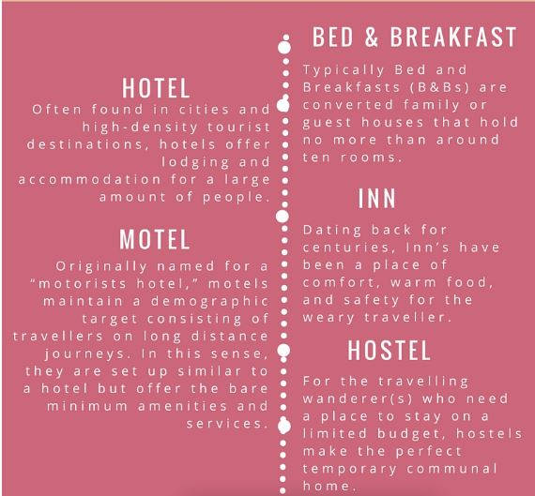
Source: https://www.professionalconnector.com/hospitality-101-different-types-of-accommodation-and/

Slide 29
Other examples of accommodation
Can you find other examples of accommodation?
Write the examples in this slide with a short definition.

Slide 30
Main types of bed
Twin or single: 38 in × 75 in (97 cm × 191 cm)
Full / Double: 53 in × 75 in (135 cm × 191 cm)
Queen: 60 in × 80 in (152 cm × 203 cm)
King: 76 in × 80 in (193 cm × 203 cm). Foundation or box spring size can be of two single L or twin XL.
California king: 72 in × 84 in (183 cm × 213 cm)
Warning! In a double standard room beds are separated. Ask for King.

Slide 31
Other room types
Hollywood twin room
Double-double
Studio
Superior (a living room connected with to one or more bedrooms)
Suite/Executive suite/Presidential suite
Connecting rooms
Murphy room (a bed that folds out of a wall or closet)
Accessible room/Disabled room
Executive Floor/Floored Room
Smoking / Non-Smoking Room
Adjoining rooms
Adjacent rooms
Cabana (with a swimming pool)
Apartment
Villa

Slide 32
 | ITA | ENG | DEU
Arredamento/ vista ENG = furniture/ view DEU = Ausstattung/ Blick | Balcone (BC) | Balcony | Balkon (BK)
 | Terrazzo (TE) | Terrace | Terrasse (TE)
 | Vista mare (VM) | Sea view | Meerblick (MB)
 | Vista mare laterale (VML) | Lateral sea view | Seitlicher Meerblick (sMB)
 | Vista giardino (VG) | Garden view | Gartenblick (GB)
 | Culla | Cradle | Wiege
 | Aria condizionata (AC) | Air conditioning (AC) | Klimaanlage (KA)

Slide 33
From check-in to check-out: the 4 stages of a hotel stay
Pre-arrival
Reservations
Arrival
Doormen and porters
Registration
Occupancy
(Currency exchange)
Safe deposits
Baggage handling
Departure
Room assignment
Issuing of keys
Baggage handling
Maintaining guest accounts
Mail and information
Telephone calls
Transportation
Transportation
Bill settlement
Check-out
Pre-arrival
Arrival
Occupancy
Departure

Slide 34
1) Arrival
Lobby
Place where guests enter and leave the hotel(HTL);
Front office/Front desk
Professionality, efficiency of the htl staff;
Quality of front office operations and services.
Waiting area: guests wait for being served by the staff of the htl.
The most important area of the lobby;
Guests form the first impression about the quality and professionality of the htl;

Slide 35
Sections of the front desk/office
Reservation desk
Analyse of inquiries
Confirmation and reservations of rooms
Modifications and cancellations
Comparison of reservation requests --> assignment of remaining unoccupied rooms to walk-in guests.
Registration desk
Registration
Room assignment
Issuing of keys
+ Bell desk (bellman: doorman and porter + newspapers and magazines to guests)
Walk-in guests: those who do not have reserved rooms previously.

Slide 36
Sections of the front desk/office
Concierge
Assistance to guests.
Cashier's desk
Foreign currency exchange
Room rate
Intermediary between guests and external arrangements and attractions(restaurant, transports, shopping, theme parks, etc.).
Room services (mini-bars, laundry,meals, alarm clock, etc.)

Slide 37
Sections of the front desk/office
Back office
Proper office
Administrative and financial operations
Guests' record
Incoming and outgoing calls
Management of wake-up calls
Telephone section

Slide 38
2) The HTL voucher
Paper or document that the travel agency gives to the customers.
Customers have to show this paper at their arrival at the hotel.
Online reservations --> confirmation mail with full payment of the service or with payment of the deposit.

Slide 39
Parts of a HTL voucher
Name of the tour agent/operator that has issued it;
Date when the service should be provided.
Details of the htl;
Name of the guests who have pre-paid the service required;
Name of the htl which should provide the service;

Slide 40
3) Hotel customer service
Customers have to be pampered, looked after by the htl staff.
Meals;
Laundry;
Mini-bar;
Telephone;
Check-out;
+
Pool;
Disco;
SPA;
Gym.

Slide 41
4) Complaints vs. L.E.A.R.N.
Listen
Empathise
Maintain eye-contact.
Look focused on WHAT the customer is saying.
Do not interrupt until the customer has burnt out/finished talking.
Ask questions to reach the root of the problem + short and open (Wh-)/closed (Y/N) questions.
Positive body language.
Take notes.
Show understanding.
Appear sincere and interested.
Nod in the right places.

Slide 42
4) Complaints vs. L.E.A.R.N.
Notify +Follow up
Act
Report the issue to your boss or senior member of staff.
"The problem has been handled";
Report
SOLVE the problem personally or give an explanation;
COMPENSATION: Refund (full/partial)or Sweetener (fruit/wine);
REPORT.
Follow up call, letter, refund or compensation;
"Thank you very much for your feedback".

Slide 43
Emotional people? --> Keep calm and be patient.Use your head!
Do not take problems personally.
Problem(s) solved? --> Loyal customer + new sales!
People have a passport of problems.
Beware of culture-bound elements, e.g. refund policy (Ireland and USA).
TIPS

Slide 44
5) Htls as event venues
Conferences, congresses, annual company parties, weddings, expos, festivals, … = extra business for htls outside peak season.
Discounted room rates for guests who stay overnight after a wedding or reunion or for delegates who attend meetings.
Services offered by htls during meetings and weddings:
Sit-down or buffet meals;
refreshments;
free Wi-Fi connection;
overhead/slide/film projector;
microphone and speakers;
screen;
video;
staff assistance and support;
(for weddings and reunions) specialised menus.

Slide 45
6) Check-out
  Baggage handling;
  Transportation;
  Bill settlement;
  Onward travelling arrangements (booking or booking confirmation at the next destination htl/at a hotel of the same chain at guests' next destination);
  Customer Comment Card (positive/neutral/negative feedback).

Slide 46
Write letters/emails of cancellation or modification
Introduction
Reasons
Apologies
Reference to previous reservation
Cancellation/Modification (+ new request/counteroffer)
Request of refund if you are entitled to it
REMEMBER!
Politeness + effective manner are the keys to success!

Slide 47
The transport sector
Air travel
Rail, road and ferry travel
The cruise sector

Slide 48
Travelling by air
The IATA classifies flights into two categories: scheduled and charter:
Scheduled flights are sold on a seat-only basis and operate to a published timetable on defined routes (eg. Ryanair, easyJet);
charter flights are booked by a holiday company to transport their customers.
Flights can be classified into:
nonstop flight (a single flight with no stop);
direct flight (a flight with one intermediate stop);
connecting flight (a flight with at least two intermediate stops).
Airports are divided into landside and airside areas.
Landside areas include car parks, rail, bus and coach stations;
Airside areas include taxiways, runways, ramps.
A flight can be domestic or international:
Domestic: it serves the need of travellers living in another country;
International: it is a gateway and provides customs and immigration facilities for incoming and monitor movements of people.

Slide 49
Rail, road and ferry travel
Rail travel is the most environmentally friendly mode of transport and is growing in popularity among tourists. It includes high-speed trains.
Road travel includes private car services. Coach travel has catered for 2 categories: young people and middle aged and elderly people.
Ferry travel: transport by ferry travel has always been an important part of travel and tourism industries. They connect coastal, lakeside and river front communities.
Rail services in Italy are provided by Trenitalia and Italo train companies. There are many types of trains:
Le Frecce: they consist of 3 separate lines: Frecciabianca, Frecciarossa and Frecciargento. They are modern and confortable, provided with AC and free Wi-Fi;
InterCity: they are fast trains that run all over Italy, connecting about 200 cities and towns;
Regional: they are local trains that operate frequent services all over Italy, including Sardinia and Sicily. They are cheap and usually reliable.

Slide 50
CRUISE SECTOR
Sightseeing.
Cruise areas: Mediterranean, the Caribbean and the Panama Canal, Scandinavia and the Baltic, Alaska, Antarctica and the Far East.
River cruise: Nile, the Rhine and Danube.
Cruises essential information: the ship's technical data, facilities and itinerary.
Price: it depends on the destinations and on the type of cabin and deck where the cabin is situated.
Ships are a sort of floating resorts with every type of entertainment at cafés in the daytime and at discos at night.
Types of cruises:
fly-cruises that combine time at sea with a charter or scheduled flight;
round the world cruises;
mini cruises;
luxury cruises, with opulence and every kind of sophistication and comfort;
Trans-Atlantic cruises that copy the legendary Titanic route;
river cruises, a quite different experience.

